Slide 1
Johann Herbart

Slide 2
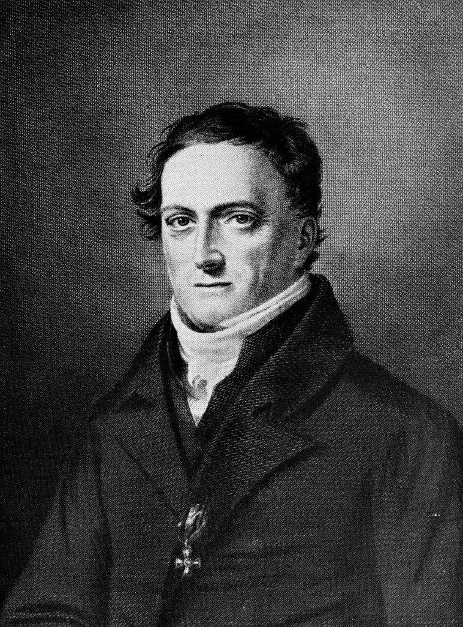
Personal Life
Born May 4, 1776 in Oldenburg, Germany
Died August 14, 1841 at age 65
Parents wanted him to get a law degree
Mother homeschooled him until he was 12 years old
Went to University of Jena
Received PhD from University of Gottingen

Slide 3
Career
1802 – Became a licentiate of University of Göttingen
1805 – Appointed extraordinary professor at Göttingen
1808 – Became a professor at Königsberg
1833 – Became professor of philosophy at Göttingen

Slide 4
Five Rules for Teaching
1. Preparation
A process of relating new material to be learned to past ideas or memories in order to give a student an interest on the topic under consideration.
2. Presentation
Using concrete objects or actual experience to teach new material.
3. Association
Thorough assimilation of the new idea through comparison with former ideas and consideration of their similarities and differences in order to put the new idea in the mind.
4. Generalization
A procedure especially important to the instruction of adolescents and designed to develop the mind beyond the level of perception and concept.
5. Application
Using acquired knowledge so that every learned idea becomes a part of the function mind and an aid to a clear interpretation of life.

Slide 5
Contribution

